Slide 1

Thermal Tests
Measured
90˚ rotated
Theatsink -> 76.4 C
Vgan = 461 mV
Igan = 7.5 A
Ploss = 3.46 W
Thermal resistance of HS 15.87 C/W heatsink resist.
Nonrotated
Theatsink -> 74 C
Vgan = 450.5 mV
Igan = 7.5 A
Ploss = 3.38 W
0.5 C/W
3.5 C/W
15.87 C/W
20 C
7.5 A source current
Rotation does not affect the result significantly but it worsened the situation

Slide 2
Thermal Tests
These results are valid for 6mm HS with the fan (LLB)
The resistance varies with temperature
Rated Loss
Ptop = 4.6 W Pbot = 3.8 W
Ptotal = 16.8 W
Similar loss is applied
The tests are completed without a failure

Slide 3

Thermal Tests
These results are valid for 6mm HS with the fan (LLB)
140˚ of junction temperature
has been achieved
Estimated thermal resistance of heatsink
$$R_{heatsink}=11.97∗T_{heatsink}^{0.356}$$

Slide 4
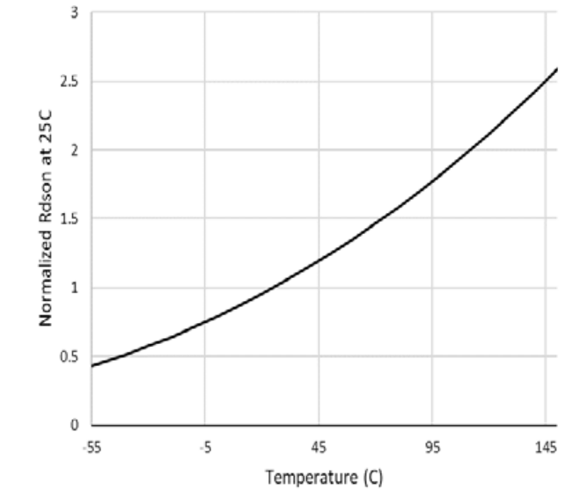
Thermal Tests
Junction temperature does not affect the on-state resistance that significantly

Slide 5
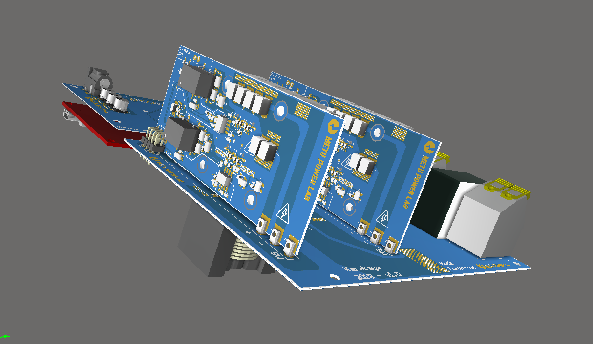
Thermal Tests - Conclusion
Version 1.0
Volume = 0.8545 lt
Power Denisty = 9.363 kW/lt
Version 1.1 – 6mm HS
Volume = 0.7652 lt
Power Density = 10.455 kW/lt
Version 1.1 – 10mm HS
Volume = 0.80901 lt
Power Density = 9.889 kW/lt
109
18.5
40
134
134 mm edge should be reduced to 125 mm to have 10 kW/lt power density

Slide 6
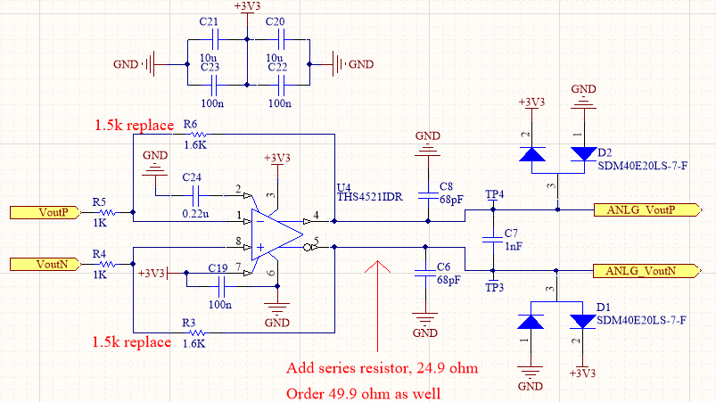
Analog Voltage Measurements
How to reduce error ?
Input Voltage
V_{DC} | V_{amp,out} | DSP
51.7 V | -263 mV | -25V ± 3
100.9 V | -505 mV | -48V ± 2.5
150.7 V | -760 mV | -72V ± 2
201.7 | -1017 mV | -98V ± 3
0.5% error at rated voltage
Output Voltage
V_{DC} | V_{amp,out} | DSP
51.11 V | -346 mV | -25V ± 2
101.2 V | -681 mV | -50V ± 2.5
150.5 V | -1012 mV | -72V ± 3
199.6 V | -1325 mV | -98V ± 2.5
0.75% error at rated voltage

Slide 7

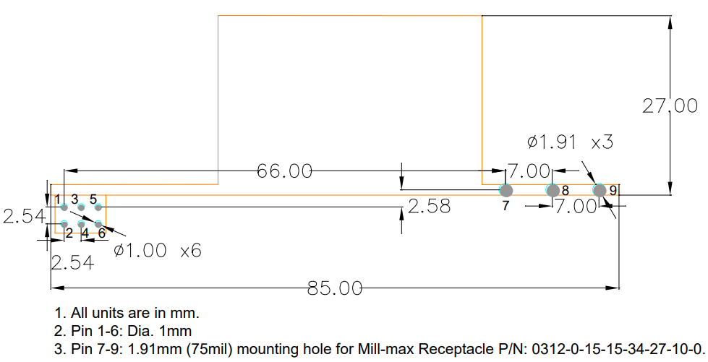

New Board Designs – Connector Selection
0.906 mm diameter
GaN Systems Solution
8 vias with 0.95 mm hole diameter

